Slide 1
SafeStep Asistant

Slide 2
About Safestep ….
SafeStep: is a trustful system which helps users to save proofs securely. Our system helps users as soon as we get a signal from them. All your emergency data is stored safely and accessible only to trusted contacts when you need help.
Founder: Azimova Sarvinoz
Location: Uzbekistan
Platform: Mobile app/ Telegram bot
Telegram bot: @SafeStepAssistantbot
Mobile app: https://safestep-site.vercel.app/

Slide 3


Slogan: Safety iN every step

Slide 4
Problem …
When you feel unsafe, who do you call when you can’t even talk
Millions face domestic violence and abuse | Fear and sitigma prevent seeking help | Victimis lack discreet, accesible support

Slide 5
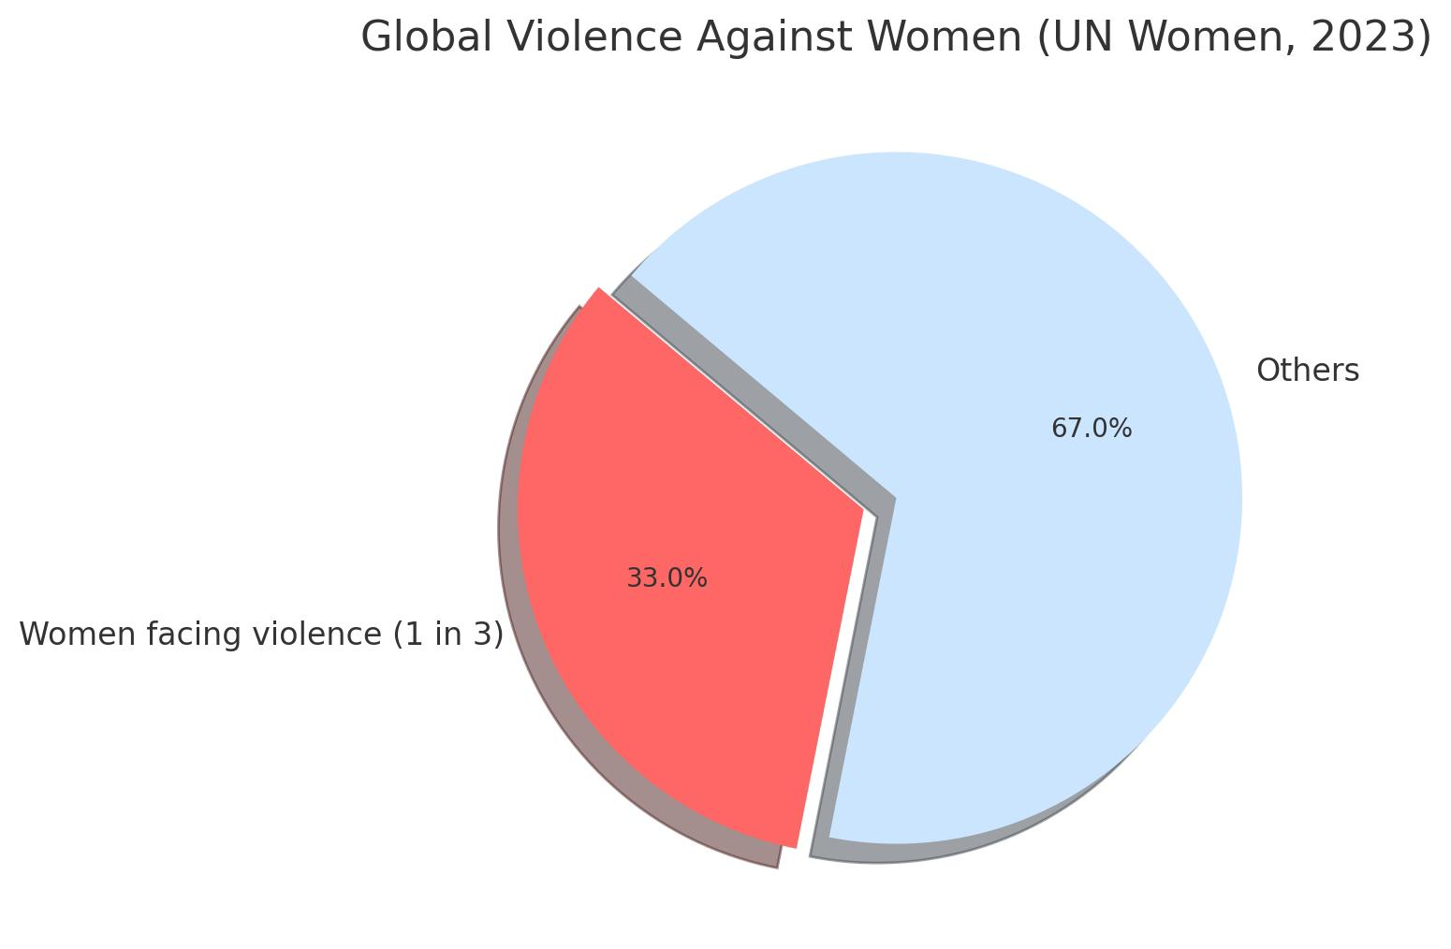
According to statistics
1 in 3 women globally face physical or sexual violence (UN Women, 2023).
• In Uzbekistan, safety-related incidents have increased by 27% in the past 2 years (Stat.uz).
• There is no fast, discreet, and localized emergency alert system.
• Most current solutions require downloading apps, which is a barrier.

Slide 6
Our Solution – SafeStep
• Instant digital alert through Google Form.
• Connected to Telegram bot for real-time notification.
• Sends user data + location to trusted contact.
• No installation needed – works in any browser.
• Easy to customize and scale for schools, dorms, public places.

Slide 7
Market Gap & Why SafeStep is Unique
• No such product exists in Uzbekistan or Central Asia.
• Global apps (like bSafe or Noonlight) are:
- Not localized
- Require installation or subscription
- Not connected to local platforms like Telegram
• SafeStep is:
✅ Telegram based
✅ No app needed
✅ Customizable
✅ Fast and free to use

Slide 8
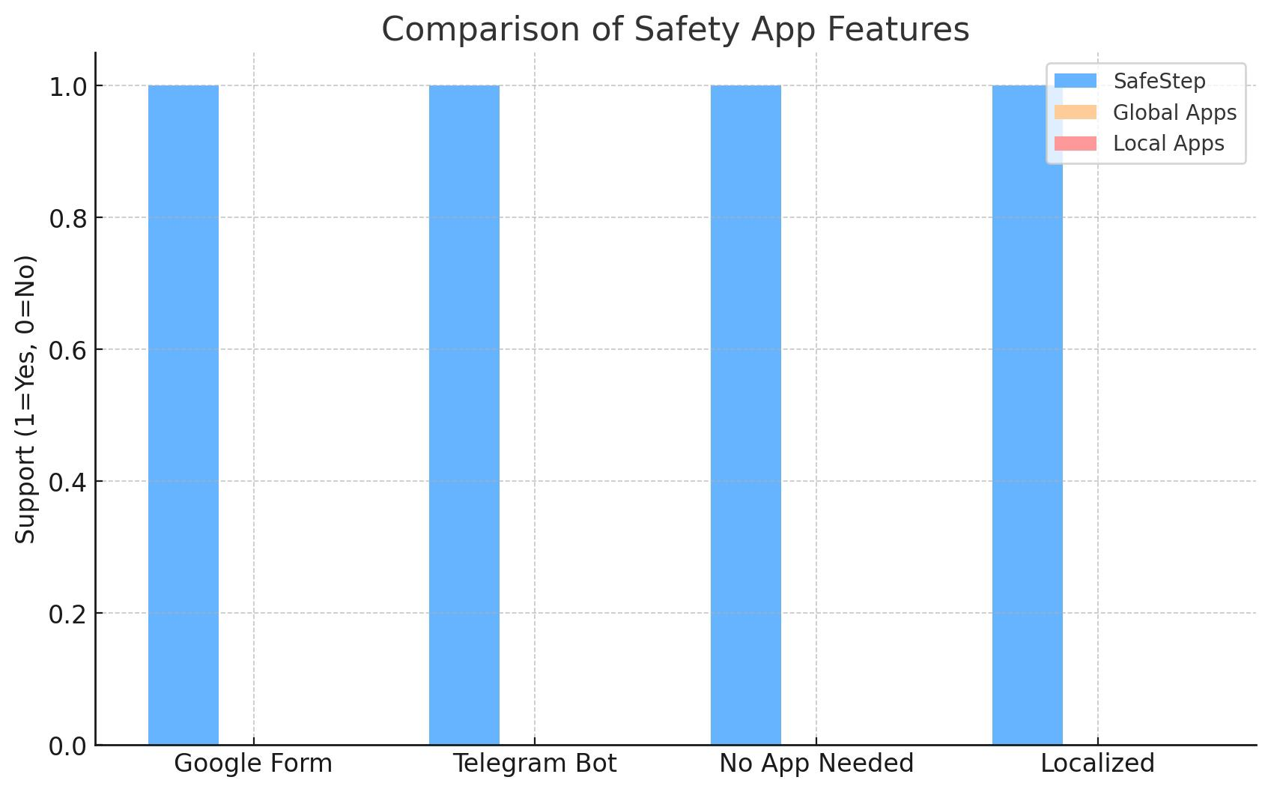
Feature Comparison
How SafeStep outperforms other apps in usability and localization.

Slide 9

Social Impact & SDGs
• SafeStep contributes to:
- SDG 5: Gender Equality
- SDG 16: Peace, Justice and Strong Institutions
• Promotes safety among youth and women in digital spaces.
• Enables authorities and schools to respond faster to threats.

Slide 10
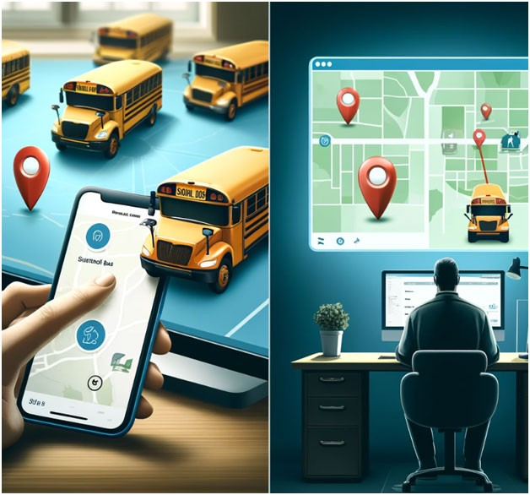
Traction & Use Cases
• Pilot tested in local schools and public awareness campaigns.
• Can be placed via QR codes in:
- Schools
- Universities
- Dormitories
- Parks
- Public transport stops

Slide 11


Next Steps for Growth
• Partner with schools, NGOs, and safety organizations.
• Launch national awareness campaign (online + offline).
• Add AI alert detection, offline QR triggers, and mobile interface.
• Seek seed funding to scale across Central Asia.

Slide 12





Meet the Team
Project Lead: Sarvinoz Azimova
Email: azimovasarvinoz2007@gmail.com
Telegram Bot: @SafeStepAssistantbot
Supported by: ChatGPT (AI Assistant), Replit,
Vercel, GitHub

Slide 13


Thank You!
Join us to build a safer, smarter world.
#StepToSafety with SafeStep

